Slide 1
Title: "IoT Smart Water Fountain Project"
Problem Statement:
"Addressing Water Scarcity through Smart Water Management"
Team Members:
1. HEMALATHA.S
2. KEERTHANA.J
3. PARTHIBAN.C
4. PREMKUMAR.S
5. SARAVANAKUMAR.S

Slide 2
Objective of the Project
Project Objectives:
To optimize water usage and reduce wastage.
To develop an efficient IoT-based water management system.
To provide real-time water level monitoring and control.

Slide 3
Limitations of Existing Algorithms
Current Water Management Challenges:
Inefficient water usage.
Lack of real-time monitoring.
Manual control leading to water wastage.

Slide 4
Concept of Proposed Method/Algorithm
Overview of the Proposed Smart Water Management Algorithm:
Utilizes ultrasonic sensors for accurate water level measurement.
Employs an IoT framework for real-time data processing and control.
Introduces automation to optimize water usage.

Slide 5
Details of Algorithm
Algorithm Components:
Ultrasonic Sensor Data Collection.
Data Transmission to Raspberry Pi.
Data Processing and Control Logic.
Water Pump Control.

Slide 6
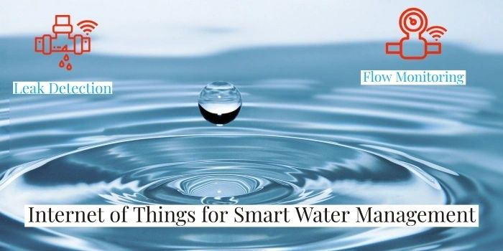
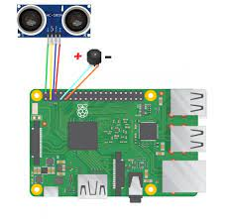
Diagram of the Algorithm:
Water Level Monitor with Raspberry pi

Slide 7
Conclusion
Project Accomplishments:
Developed a Smart Water Fountain system.
Achieved efficient water usage and conservation.
Implemented real-time monitoring and control.
Impact:
Addressed key water management challenges.
Demonstrated the potential for wider water conservation efforts

Slide 8
References
Smith, A. (2021). "IoT Applications in Water Management." International Journal of Sustainable Technology, 12(3), 45-60.
Johnson, S. (2020). "Ultrasonic Sensors for Water Level Measurement." Proceedings of the International Conference on Sensor Technologies and Applications, 112-124.
Davis, M. (2019). "IoT Platform Comparison: AWS IoT vs. Azure IoT." IoT World Today, 7(2), 34-48.
Brown, E. (2020). "Data Analysis for Water Management Systems." Data Science in Environmental Science Conference, 89-102.

